Slide 1
Complementarity and Evolution of Contractual Provisions: An Empirical Study of IT Services Contracts
Argyres, Bercovitz, and Mayer (2007)

Slide 2
Introduction
Literature on managing outsourcing relationships: the structure of the agreement affects the performance of the relationship.
Management mechanism: trust as a substitute to contracts.
Economics mechanism: contract designs are equilibrium outcomes of competition.
Gap: little focus on how contracts are actually designed and how their structures evolve.
Focus on the relationships among different elements of contract designs, and;
Analysis of the coevolution of those characteristics over time.

Slide 3
Research Question
Two key categories of contractual provisions under environmental uncertainty, or task or technological complexity: task description and contingency planning.
Research Question: How are learning processes reflected in systematic relationships between contingency planning and task description contractual provisions?
Motivation: proposition that as partners learn about the matching possibilities between transactional features of contracts, they can better exploit the complementarities between them.
Also, as learning evolves over time, contingency planning might be increased, contradicting the view that trust substitutes contracts and supporting the idea of “learning to contract”.

Slide 4
Theoretical background
TCE: bounded rationality → incomplete contracts (Williamson 1975, 1985). Thus, contract terms reflect certain key characteristics of the transaction:
The degree of bilateral dependency between parties and the available legal protection of property rights.
As hazard increases, additional safeguards against opportunism are needed.
Potential solution - write more detailed/complete contracts:
• Adding contingency planning clauses, which are defined as “the parts of a contract that are designed to support within-agreement adjustments by proscribing the ways in which the contractual partners will deal with problematic contingencies that might arise during the execution of the contract.”
• Including more detailed specification of the task to be completed.

Slide 5
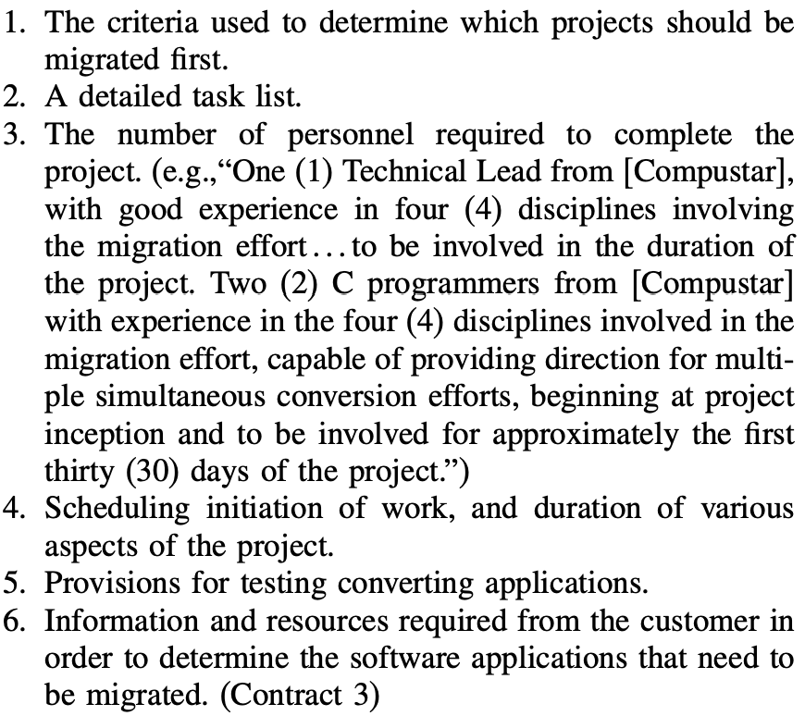
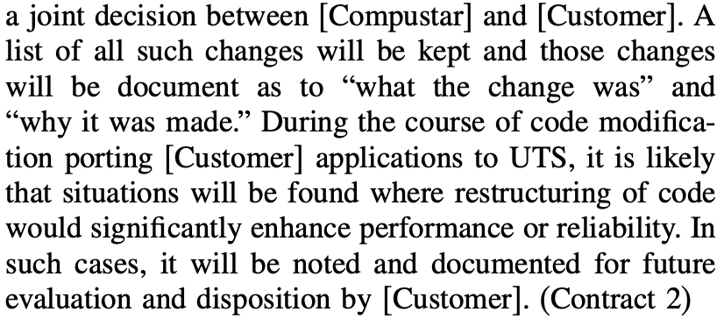
Examples
Contingency planning
Task description

Slide 6
Theoretical background
Tradeoffs in increasing contract completeness:
Due to bounded rationality, it is costly to identify additional possible future contingencies and to describe tasks in detail;
Also, on the one hand, leaving a contract incomplete allows for more flexibility;
On the other hand, however, incomplete contracts leave more room for opportunism.
→ Important question: whether various types of contractual provisions act as complements or substitutes for one another when firms invest in transaction planning and contract design.

Slide 7
Hypotheses
Substitutive or complementary relationship?
Agency theory perspective: contingency planning and task specification are alternative (substitute) mechanisms for monitoring and controlling behavior in an agency type of relationship.
Organization theory: many features of an organization’s structure (e.g., incentive arrangements) fit together in particular ways, such that contractual provisions might be complementary to each other.
Learning to achieve organizational fit over time (Siggelkow, 2002): slow learning of possible combinations and cross-provisional learning → developing one category of contractual provision may provide gains to understanding transaction features that are relevant for other provisions
More efforts devoted into contingency planning decreases the marginal cost of including more detailed task description (and vice-versa).
H1. Contingency planning and task description have reciprocal positive effects on one another, suggesting that they act as complements in complex, high-technology contracts.

Slide 8
Hypotheses
Learning spillover as the underpinning mechanism
Correlation vs causality: some buyers or sellers may simply insist on more detailed contracts in all categories for their own bureaucratic reasons.
Time lag to pin down learning effects: are efforts at contingency planning made for previous contracts associated with increases in the extensiveness of task descriptions in later contracts with the same partner? (vice versa)
• Contingency planning → Task description: parties can use their knowledge of problematic contingencies to improve on the task description in subsequent contracts with the partner to avoid those contingencies in the future.
• Task descriptions → Contingency planning: efforts at describing tasks in detail for a prior contract naturally stimulate search for what might prevent the fulfillment of task obligations in the future.
H2A. Prior experience with contingency planning is associated with more detailed task description in subsequent contracts between the same firms.
H2B. More detailed task description in prior contracts is positively associated with contingency
planning in subsequent contracts between the same firms.

Slide 9
Hypotheses
Partner-specific learning
As parties work together, they gain knowledge on features of their transactions and each other’s idiosyncrasies.
Accumulated partner-specific knowledge may enable the parties to codify roles and responsibilities in more detail (task description), and to specify contingencies with more accuracy (contingency planning) at lower costs.
Partner-specific learning as a source of sunk investment: as partners learn to work together, they often develop relationship-specific routines (Zollo et al. 2002). As the relationship continues, it becomes easier to work together, and the costs of switching to a new partner rise.
As a result, more efforts will be devoted to contingency planning and detailed task descriptions to prevent misunderstandings and to ensure the continuity of relationship.
H3A. As an exchange relationship between two parties continues, the parties will be more likely to include contingency planning clauses in their contracts with each other.
H3B. As an exchange relationship between two parties continues, the parties will include more detailed task descriptions in their contracts with each other.

Slide 10
Hypotheses
The role of trust
Sociologists and organization theorists: the social context of the transaction matters.
As relationships evolve and trust develops, relational governance can provide the same safeguarding benefits as contracts without many of the disadvantages. → substitutive relationship.
Present article and Mayer and Argyres (2004): greater contract detail creates an environment that helps trust develop rather than contributes to its decline.
Task description and contingency planning provisions do not carry the specific negative connotations of a penalty clause. Thus, they do not necessarily imply that a breach of trust is anticipated.
More detailed contracts enhanced the trust between parties over time → complementary relationship.
The coordination function of contracts is not necessarily in conflict with the operation of a trust mechanism.

Slide 11
Data
Empirical context: IT services contracts from Compustar, a supplier of IT services and computer-related hardware (high environmental uncertainty & technological complexity)
Sample size and time range: 405 agreements between 1986 ~1998
Dependent variables:
Task description: 1-7 Likert-type scale
Contingency planning: binary (1: contains contingency planning; 0: otherwise)
Independent variables:
Prior (t-1) task description
Prior (t-1) contingency planning
Relationship history: the amount of time in weeks that Compustar had worked with a particular business unit of a partner company prior to signing the contract in question.
Control variables: underpinning characteristics of the transaction that affect contractual provisions – interdependence, proprietary assets, measurement costs, mainframe (uncertainty), innovation, total value.

Slide 12
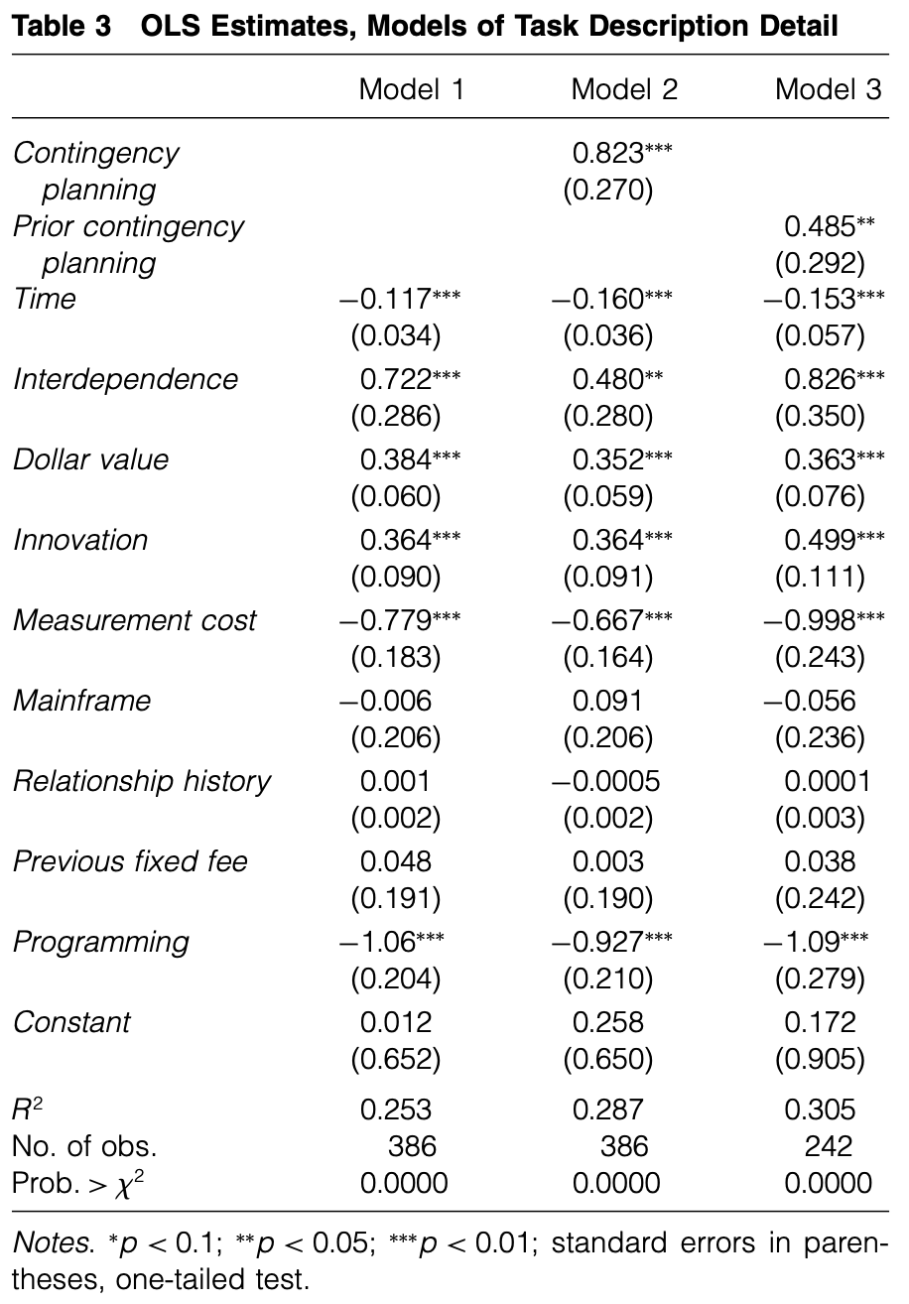
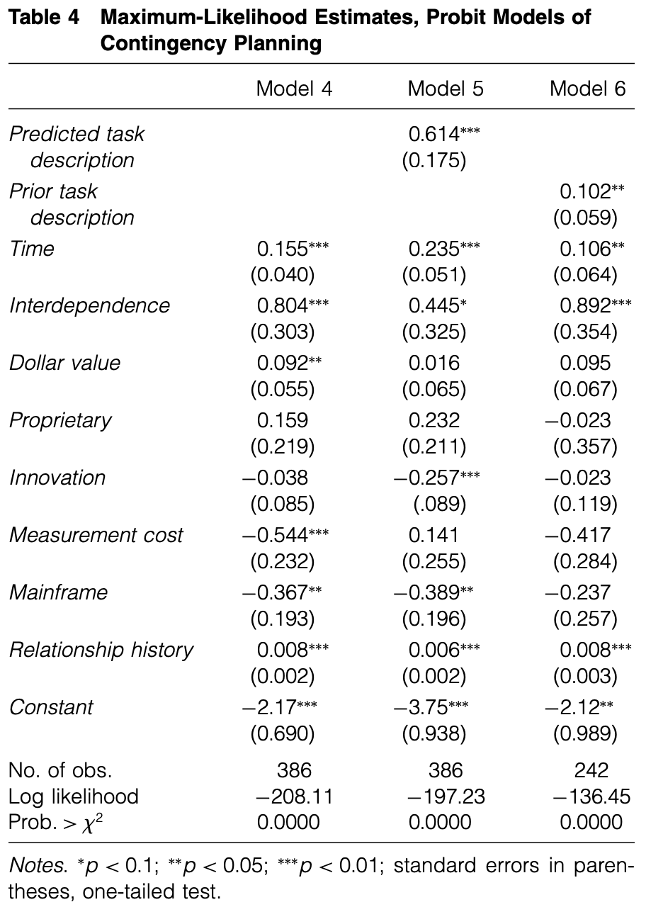
Empirical results
H1
H1
H2A
H2B
H3A
H3B

Slide 13
Discussion and Conclusion
Key findings
(1) Task description and contingency planning have reciprocal positive effects on each other in our sample of contracts, and these effects are statistically significant across contracts written by the same two partners over time.
(2) As partners contract with each other over time, they tend to include more, not less, contingency planning in their contracts.
Unexpected results: negative effects of time on task descriptions
Reputation effect: Over time, Compustar’s reputation for honest dealing became stronger among buyers, leading buyers to be less demanding of detailed task description.
The removal of unnecessary task description clauses: Compustar learned that some types of detail were unnecessary in the contract, and buyers agreed.
Limitations
Due to data restrictions, trust and performance are not observed.

